Slide 1
Mining NIH Grant Data

Slide 2
Data Sources
~2.2 million grants
~30 years (1985-present)
~253 thousand PIs
~118 thousand terms
~57 million grant-term relations

Slide 3
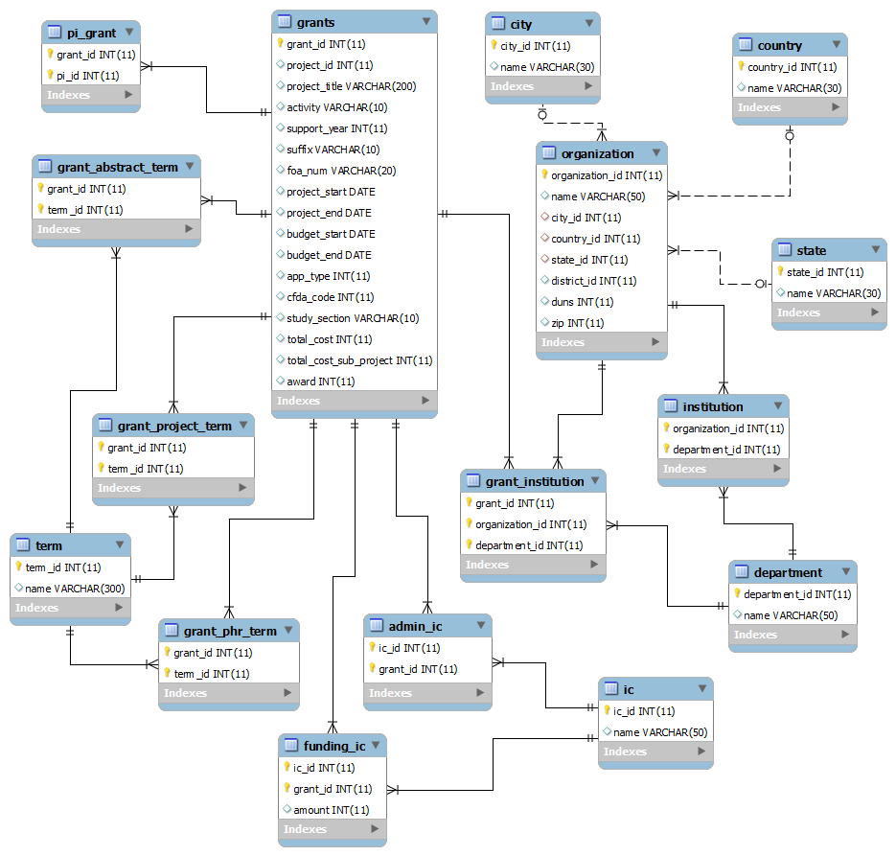

Slide 4
General Statistics: Grants per Year

Slide 5
General Statistics: Grants per City

Slide 6
General Statistics: Grants per County

Slide 7
General Statistics: Grants per State

Slide 8
General Statistics: Grants per PI

Slide 9
General Statistics: Funding per Year

Slide 10
General Statistics: Funding per City

Slide 11
General Statistics: Funding per County

Slide 12
General Statistics: Funding per State

Slide 13
General Statistics: Funding per PI

Slide 14
Co-PI Network Analysis
Closeness
Betweeness
Network Constraint
Clustering Coefficient
PageRank

Slide 15
Data Visualization
Co-PI Network
US Heat Map

Slide 16
Grant Clustering
50th of dataset
Equal distribution of years

Slide 17
References

